Slide 1
Java script
Chapter 3

Slide 2
Lesson objective
After this lesson, you will be able to:
Define JavaScript variables.
Create JavaScript statements.
Create function declarations.
Create function expressions.
Convert objects to a different type.
Write conditional statements.
Write looping statements.
Handle errors.

Slide 3
JavaScript History and Versions
JavaScript was introduced as part of the Netscape 2.0 browser
Microsoft soon released its own version called JScript
(European Computer Manufacture Association) ECMA developed a standard language known as ECMAScript
ECMAScript Edition 3 is widely supported and is what we will call “JavaScript”
Notes:
Scripting language (object-oriented)
Lightweight programming language developed by Netscape
It is a subset of Java
Interpreted language, not compiled
Designed to be embedded in browsers
Ideal for adding interactivity to HTML pages
Detect browser versions
Work with info from user via HTML forms
Create cookies
Validate form data
Read and write HTML elements
It’s free, no license required

Slide 4
What is JavaScript
Syntax is similar to Java, but it’s not Java per se
Usually JavaScript code is embedded within HTML code using the script tag:
Can have more than one pair of script tags in a page
Semicolons: C++ and JAVA require them but in JavaScript it’s optional

Slide 5
Scripting language (object-oriented)
Lightweight programming language developed by Netscape
It is a subset of Java
Interpreted language, not compiled
Designed to be embedded in browsers
Ideal for adding interactivity to HTML pages
Detect browser versions
Work with info from user via HTML forms
Create cookies
Validate form data
Read and write HTML elements
It’s free, no license required

Slide 6
What is JavaScript
HelloWorld example program…
<html>
<head><title>JavaScript HelloWorld!</title></head>
<body>
<script language="JavaScript">
document.write('Javascript says "Hello World!"')
document.write(for(int i=0;i<=10;i++))
</script>
after script
<h1> sample text </h1>
</body>
</html>
Notes:
To insert a JavaScript into an HTML page, we use the <script> tag (also use the type attribute to define the scripting language).
So, the <script type="text/javascript"> and </script> tells where the JavaScript starts and ends:
By entering the document.write command between the <script type="text/javascript"> and </script> tags,
the browser will recognize it as a JavaScript command and execute the code line. In this case the browser will write Hello World! to the page:

Slide 7
What is JavaScript
Javascript can be located in the head, body or external file
Head section
Ensures script is loaded before trigger event
Body section
Script executes when body loads
External
Allows scripts to run on several pages

Slide 8
What is JavaScript
JavaScript statements in head written to the beginning of the body section but don’t violate HTML code already there
JavaScript statements in body written based on their location
JavaScript interpreted first then HTML interpreted second
Document.write writes to the HTML document not the web page

Slide 9
What is JavaScript
<html>
<head>
<script language=“JavaScript”>
document.write (“<b> This is first </b>);
</script>
</head>
<body>
Now where does this print on the web page???? <br />
<script language=“JavaScript”>
document.write ( “This might be last?”)
</script>
</body>
</html>
This is first
Now where does this print on the web page???? This might be last?

Slide 10
What is JavaScript
Now, let JavaScript generate HTML for us…
<html>
<head><title>JavaScript HelloWorld!</title></head>
<body>
<script laguage="JavaScript">
document.write("<h2>Javascript-Generated output:</h2>"
+ "<p>This paragraph generated by JavaScript</p>"
+ "<p>It can even insert an image</p>"
+ "<img src=‘ASTU.jpg' />")
</script>
</body>
</html>

Slide 11
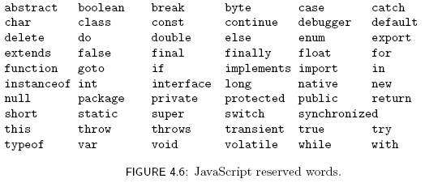
Identifier
Identifier– a name given to a program element
Syntax rules for names (identifiers):
Must begin with letter or underscore ( _ )
Must contain only letters, underscores, and digits (or certain other characters)
Must not be a reserved word
Case Sensitive!!

Slide 12
Variables and Data Types
Type of a variable is dynamic: depends on the type of data it contains
JavaScript has six data types:
Number
String
Boolean (values true and false)
Object
Null (only value of this type is null)
Undefined (value of newly created variable)

Slide 13
Variables
Must declare variables before they’re used in the program
Declare at the top of the program & terminate each statement with ‘;’
Initialize variables when appropriate
Local variables (declared within a function) destroyed after function exit
Can only be accessed within the function
Syntax:
var idf [= expression];
Example – Note Assignments
var x= 2.50;
var taxRate = .075;
var y;

Slide 14
JavaScript Operators
Operators are used to create compound expressions from simpler expressions
Operators can be classified according to the number of operands involved:
Unary: one operand (e.g., typeof i)
Prefix or postfix (e.g., ++i or i++ )
Binary: two operands (e.g., x + y)
Ternary: three operands (conditional operator)

Slide 15
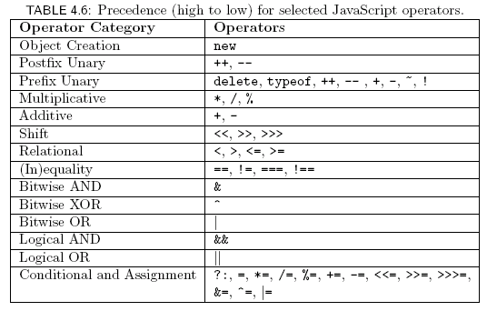
JavaScript Operators
Precedence (high to low) of operators

Slide 16
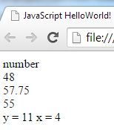
Example
<html>
<head><title>JavaScript HelloWorld!</title></head>
<script language='JavaScript'>
var x = 3;
var y = 10;
document.write(typeof x + "<br/>") ;
document.write(x++ * ++y + y +x + "<br/>") ;
x = 3;
y = 10;
document.write(++x * ++y + y /x + y + "<br/>") ;
x = 3;
y = 10;
document.write( ++x * y++ + y +x + "<br/>" ) ;
document.write ( "y = " + y + " x = " + x );
</script>
</body>
</html>

Slide 17
JavaScript Operators: Automatic Type Conversion
Binary operators +, -, *, /, % convert both operands to Number
Exception: If one of operands of + is String then the other is converted to String
Relational operators <, >, <=, >= convert both operands to Number
Exception: If both operands are String, no conversion is performed
Operators ==, != convert both operands to Number
Exception: If both operands are String, no conversion is performed
Unary +, - convert their operand to Number
Logical &&, ||, ! convert their operands to Boolean

Slide 18
Conditional Statements--if
if (some Boolean expression is true){ execute the statements within the curly braces, otherwise skip to the first statement after the closing brace
}
Resume execution here in either case

Slide 19
Conditional Statements– if/else
if (some Boolean expression is true){
execute these statements, otherwise skip to ‘else’ clause
}
else {
execute these statements if Boolean expression is false
}
Resume execution here in either case

Slide 20
Conditional Test Program
Diagnostic messages indicate in the flow of control
<html>
<head><title>JavaScript</title></head>
<body>
<script laguage="JavaScript">
var variable1 = 1; var variable2 = 2;
if(variable1 >= 0){
document.write("<p> 1 is greater than 0 </p>");
}
document.write("<p>Resuming execution after 'if' statement</p>");
if(variable1 > variable2){
document.write("<p>1 is greater than 2</p>");
}
else {
document.write("<p>2 is greater than 1</p>");
}
document.write("Resuming execution after 'if/else' statement</p>");
</script>
</body>
</html>

Slide 21
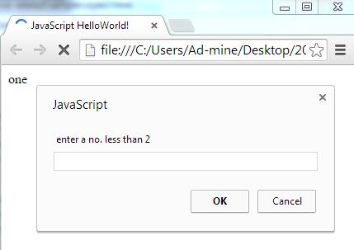
Switch example
<script type="text/javascript">
var x = window.prompt(" enter a no. less than 2");
x= Number(x)
switch (x)
{
case 0: document.write("zero") ; break ;
case 1: document.write("one") ; break ;
default: document.write("not valid")
}
</script>

Slide 22
Strings
Strings are sequences of keyboard characters enclosed in single or double quotes
“Hello World” or ‘Hello World’
Variables can hold strings
var greeting = “Hello World”
String can be empty, i.e., contain no characters
var myAnswer = “”
Use ‘\’ (escape symbol) to ‘type’ prohibited characters
\b for backspace, \n for newline, \t for tab, \” for double quote

Slide 23
Using Arrays
An array is an ordered collection of values referenced by a single variable name
var variable = new Array(size);
Where variable is the name of the array variable and
size is the number of elements in the array

Slide 24
Working with Program Loops
A program loop is a set of instructions that is executed repeatedly
Use program loops to configure a group of commands to be executed a set number of times
The loop uses a counter to track the number of times the command block has been run

Slide 25
Working with Program Loops
<table border = 2>
<tr>
<script type = "text/javascript">
for (num = 1; num <= 4; num ++){
document.write("<td>" + num + "</td>");
}
</script>
</tr>
</table>

Slide 26
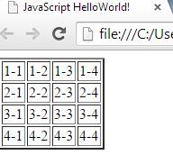
Working with Program Loops
<table border = 2>
<script type = "text/javascript">
for (num = 1; num <= 4; num ++){
document.write("<tr>");
for (J = 1; J <= 4; J ++){
document.write("<td>" + num + “-” + J + "</td>");
}
document.write("</tr>");
}
</script>
</table>
Nesting a For loop

Slide 27
Working with Program Loops
<table border = 2>
<tr>
<script type = "text/javascript">
num = 1;
while(num <= 4){
document.write("<td>" + num + "</td>");
num ++;
}
</script>
</tr>
</table>
Creating a While loop

Slide 28
Working with Program Loops
<table border = 2>
<script type = "text/javascript">
num = 1;
while(num <= 4){
document.write("<tr>");
J = 1;
while(J <= 4){
document.write("<td>" + num + J + "</td>");
J ++;
}
document.write("</tr>");
num ++;
}
</script>
</table>
Nesting a While loop

Slide 29
Exercise
Write a script using a loop to Create
unordered list
Ordered list

Slide 30
JavaScript Functions
Abstraction
Functions allows to reduce the size of program
It allows writing functionality once, then reuse it
Encapsulation
Functions encapsulate a specific capability or feature
Function name allows us to access a function in our program
Parameterization
A function may accept parameter

Slide 31
JavaScript Functions
Reasons to use functions
Facilitate communication
Problem simplification
Code readability
Reusability
Maintainability
In JavaScript, functions are the primary encapsulation mechanism

Slide 32
JavaScript Functions
JavaScript function syntax
function fname (argument_1, ... , argument_n) { statement_1; statement_2; ... statement_m; return return_value; }

Slide 33
JavaScript Functions -- Parameters
Passing parameters to the function
Parameters provide value to the function
Refers to implicitly declared variables that can be accessed within function body
Parameters are named variables separated by commas
Example,
function findMaxValue(num1, num2, num3)

Slide 34
JavaScript Functions
Put functions within <script>….</script> tags within the <head> section of the web page
<head>
<script language=“JavaScript”>
declare functions here….
</script>
</head>

Slide 35
JavaScript Functions – Local Variables
Variables declared within a function are local
local variable is visible only within the function body after it’s declared
Commonly used to store results of an intermediate calculation

Slide 36
JavaScript Functions – Local Variables
Write a function that returns the max of three numbers
function findMaxValue(num1, num2,num3) {
var tempMax; //local var
if (num1 >= num2) {
tempMax = num1;
}
else {
tempMax = num2;
}
if(num3 >= tempMax) {
tempMax = num3;
}
return tempMax;
}

Slide 37
JavaScript Functions – function calling
Calling statement: allows to invoke already declared function.
Syntax:
[idf=] functionName([Actual_parameter_list]);
Example…somewhere in the <body>….,
var x = 1, y = 4, z = 2;
var y = findMaxValue(x, y, z);

Slide 38
JavaScript Functions - Return
Return keyword tells function to return some value and exit immediately
Syntax:
return expression;
Function can have multiple return statements but only the first can be executed in any given function call
Normally used to return the final result of a calculation to the calling program

Slide 39
JavaScript Functions – Parameter Sequence
When calling functions, must enter parameters in same order as specified in function argument list.
Notice, the actual and formal arguments are in one-to-one correspondence in order and number
function calculateDensity(height, width, depth, mass){
var volume = height * width * depth;
var density = mass / volume;
return density;
}
……………………………………………….
var hth = 2, wth = 3, dth = 4, mass = 10;
var result = calculateDensity(hth, wth, mass, dth);

Slide 40
JavaScript Functions – Global Variables
Global variables are those declared outside of functions
Are visible throughout the program
var globalHello = “Hello!”;
function writeHello() {
document.write(globalHello);
}
// outputs “Hello!”

Slide 41
JavaScript Functions
Built-In Functions
Prompt
Alert
Confirm

Slide 42
JavaScript objects

Slide 43
Object Introduction
Everything" in JavaScript is an Object: a String, a Number, an Array, a Function....
In addition, JavaScript allows you to define your own objects.
An object is a set of properties
A property consists of a unique name (within an object) with an associated value
The type of a property depends on the type of its value and can vary dynamically.
An object is just a special kind of data, with properties and methods.
There are no classes in JavaScript
Instead, properties can be created and deleted dynamically

Slide 44
Object Creation
Objects are created using new expression
A constructor is a function
new object([argument list])
When called via new expression, a new empty Object is created and passed to the constructor along with the argument values
Constructor performs initialization on object
Note:
JavaScript also has several built-in objects, like String, Date, Array, and more.

Slide 45
Three ways to create an object
One can use an object literal:
var course = { number: "CS621", teacher:“Kebede" }
One can use new to create a “blank” object, and add fields to it later:
var course = new Object(); course.number = "CS621 "; course.teacher = "Kebede ";
One can write and use a constructor:
function Course(n, t) { // best placed in <head> this.number = n; this.teacher = t; }
var course = new Course(" CS621", " Kebede );
Notes:
Note: this keyword is used to refer to the object that has been passed to the function.

Slide 46
Object Methods
Methods are the actions that can be performed on objects.
Creating objects in JavaScript using the constructor function
function rect (length, width){
this.length = length;
this.width = width;
}
One can use the new keyword and call our rect constructor function myrect = new rect (100, 200);
To add methods to your objects, first define a function
Then associate that function with a particular object.
function makeLonger() {
this.length += 5;
}

Slide 47
JavaScript Arrays
The Array built-in object can be used to construct(create) objects with special properties and that inherit various methods
ary1
length (0)
Properties
Inherited
methods
toString()
sort()
shift()
…

Slide 48
Four ways to create an array
One can use an array literal: var colors = ["red", "green", "blue"];
One can use new Array() to create an empty array:
var colors = new Array();
One can add elements to the array later: colors[0] = "red"; colors[2] = "blue"; colors[1]="green";
One can use new Array(n) with a single numeric argument to create an array of that size
var colors = new Array(3);
One can use new Array(…) with two or more arguments to create an array containing those values:
var colors = new Array("red", "green", "blue");

Slide 49
JavaScript Arrays
Changing the number of elements:
var ary2 = new Array (4, true, “OK”);
Ary2[3] = -12.6;
Ary2.length = 2;

Slide 50
JavaScript Arrays
Methods inherited by array objects, and return a reference to the array on which they are called

Slide 51
JavaScript Arrays
var stack = new Array();
stack.push (‘h’);
stack.push (‘i’);
var v1= stack.pop();
var v2 = stack.pop ();
window.alert(v1 + v2);

Slide 52
Built-in Objects
The global object
Named window in browsers
Has properties representing all global variables
Other built-in objects are also properties of the global object
Ex: initial value of window.Array is Array object

Slide 53
Built-in Objects
String(), Boolean(), and Number() built-in functions can be called as constructors, created “wrapped” Objects:
Instances inherit valueOf() method that returns wrapped value of specified type:
var wrapperdNumber = new Number(5.625)
window.alert( typeof wrappedNumber.valueof());
Output is “number”

Slide 54
Built-in Objects
Other methods inherited by Number instances:
Outputs
5.63
5.63e+0

Slide 55
Built-in Objects
Properties provided by Number built-in object:
Number.MIN_VALUE:
smallest (absolute value) possible JavaScript Number value
Number.MAX_VALUE:
largest possible JavaScript Number value

Slide 56
Built-in Objects
Some of the methods inherited by String instances

Slide 57
Built-in Objects
The Date() built-in constructor can be used to create Date instances that represent the current date and time
Often used to display local date and/or time in Web pages
Other methods: toLocaleDateString() , toLocaleTimeString(), etc.
var now = new Date();
window.alert(“Current date and time:” + now.toLocaleString());

Slide 58

Built-in Objects
valueOf() method inherited by Date instances returns integer representing number of milliseconds
Automatic type conversion allows Date instances to be treated as Numbers:

Slide 59
Built-in Objects
Math object has methods for performing standard mathematical calculations:
Also has properties with approximate values for standard mathematical quantities, e.g., e ( Math.E ) and π (Math.PI)

Slide 60
Built-in Objects
Methods of the Math built-in object

Slide 61
JavaScript and HTML Forms
Object Model for the Browser Window
Compound object structure is created when a web page loads into a browser
Hierarchy
Window is an object, the HTML document is an object and its elements are objects
These objects have primitives associated with them

Slide 62
DOM(Document Object Model)
The DOM is a programming interface (an API) for HTML and XML pages.
is a platform- and language-neutral interface that will allow programs and scripts to dynamically access and update the
content,
structure, and
style of documents.
It provides a structured map of the document, as well as a set of methods to interface with the elements contained in HTML pages.
Effectively, it translates our markup into a format that JavaScript (and other languages) can understand.
Notes:
We can use it to find elements by their
names or attributes, then add, modify, or delete elements and their content.

Slide 63
DOM
DOM serves as a map to all the elements on a page.
The document can be further processed and the results of that processing can be incorporated back into the presented page
The DOM represents a hierarchy of objects, forming a model of your HTML document.
Use the built-in document variable to retrieve elements from the DOM which references the DOM and perform one of the search methods.
With out DOM, JavaScript wouldn’t have any sense of a document’s Contents entirely
JacvaScript can access and manipulate everything from the page’s doctype to each individual letter in the text via DOM

Slide 64
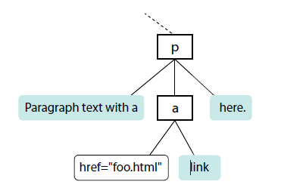
The DOM is a collection of nodes making up a document tree
Element nodes
Attribute nodes
Text nodes
Each element within the page is referred to as a node
<p>Paragraph text with a
<a href=“index.html">link</a>
here.</p>
Index.html
Notes:
If you think of the DOM as a tree, each node is an
individual branch that can contain further branches.
But the DOM allows deeper access to the content
than CSS because it treats the actual content as a node
as well.

Slide 65
DOM
also provides a standardized set of methods and functions through which JavaScript can interact with the elements on our page.
Most DOM scripting involves reading from and writing to the document.

Slide 66
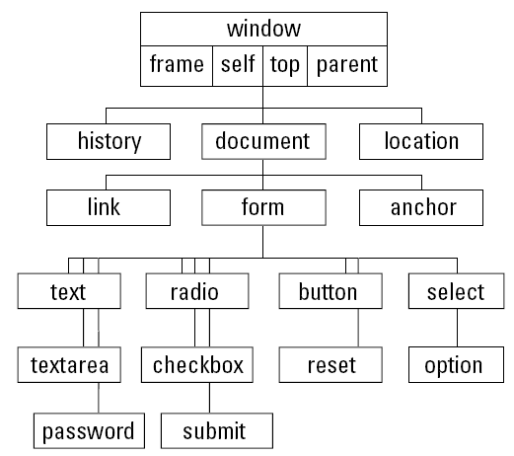
Basic object model
The lowest common denominator browser document object hierarchy
Notes:
The hierarchical structure starts with the window and drills inward toward the document, forms, and form elements. A document is a largely immutable page on the screen.
Only elements that are by nature interactive—links and form elements such as text fields, buttons, and so on—are treated as objects with properties, methods, and event handlers.

Slide 67
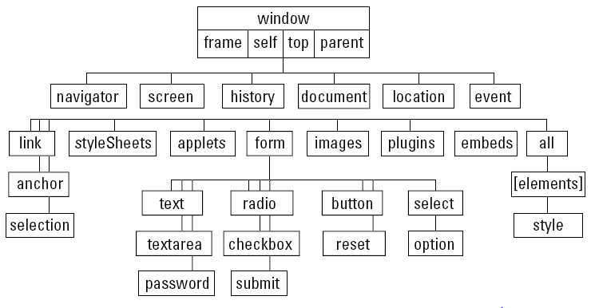
Object model
The IE4 document object hierarchy

Slide 68
JavaScript and HTML Forms
window [closed, location]
document [bgColor, fgColor, URL, lastmodified,linkColor, vlinkColor]
images [properties]
links [properties]
frames [properties]
forms [properties]

Slide 69
JavaScript and HTML Forms
Window object is parent of structure
window.closed is primitive that is Boolean
window.location primitive contains string of the URL of the HTML file
window.document object is primary focus
When web page is loaded the HTML elements assign values to most of these window.document primitives
Often the word window is excluded as in document.write but need it if referring to multiple open windows
Properties can also be objects

Slide 70
JavaScript and HTML Forms
<HTML>
<HEAD>
<TITLE>Document Properties</TITLE>
<SCRIPT LANGUAGE=JavaScript><!--
document.write(closed);
document.write("<BR>"+ document.bgColor);
document.write("<BR>"+document.fgColor);
document.write("<BR>"+document.lastModified);
//--></SCRIPT>
</HEAD>
<BODY TEXT="#0000FF" BGCOLOR="#FFFFCC">
<P>Blue text on a yellow background.<BR>
<SCRIPT LANGUAGE=JavaScript><!--
document.write("<BR>"+ document.bgColor);
document.write("<BR>"+document.fgColor);
//--></SCRIPT>
</BODY>
</HTML>

Slide 71
JavaScript and HTML Forms
User Events
An event occurs when a user makes a change to a form element
Ex. Click a button, mouseover an image
Detection of an event done by event handlers
Event handler is an attribute of the HTML button
<form>
<input type=button value=“please click” onclick=“functionname()”>
</form>

Slide 72
JavaScript and HTML Forms
<HTML>
<HEAD>
<SCRIPT LANGUAGE=JavaScript><!--
function changecolor(){
document.bgColor= “yellow”
}
function changecolor2(){
document.bgColor=“blue";
}
//--></SCRIPT>
</HEAD>
<BODY OnLoad =“changecolor2()”>
<P>
<FORM>
<P><INPUT TYPE=button VALUE="Click Me" onclick="changecolor()">
</FORM>
</BODY>
</HTML>

Slide 73
JavaScript and HTML Forms
Form Object: Window.document.form
A form is a property of the document but is also an object
Form elements are properties of a form and are also objects
Access to form’s properties is done through the NAME attribute of the FORM tag
Access to the properties of the form elements is done through the NAME attributes of the particular form element

Slide 74
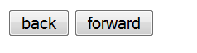
Working on History object
<head>
<title>History object </title>
<script language=javascript>
function navigat(x){
history.go(x)
}
</script>
</head>
<body>
<form>
<input type="button" value = "back" onclick = “navigat(-1)”/>
<input type ="button" value ="forward" onclick = "navigat(1);" />
</form>
</body>
</html
Javascript:history.go(-1)

Slide 75
Working on window
<form>
<input type ="button" value = "New window" onclick = "window.open(‘url’)" />
</form>

Slide 76
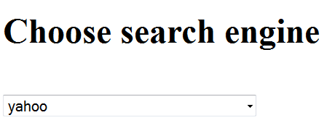
OnChange event
function SearchHandler()
{
var i = document.pulldown.selectSearch.selectedIndex;
var url = document.pulldown.selectSearch.options[i].value;
window.open (url);
}
…
<h1>Choose search engine </h1><br />
<form name ="pulldown" id ="pulldowni">
<select name ="selectSearch" onchange ="SearchHandler();" >
<option value ="http://www.google.com">google</option>
<option value ="http://www.yahoo.com">yahoo</option>
<option value ="http://www.altavista.com">altavista</option>
</select>
</form>
onchange ="SearchHandler();"

Slide 77
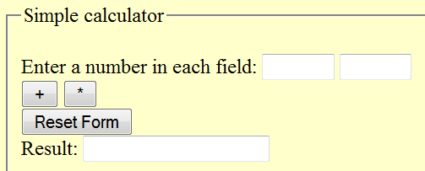
JavaScript and HTML Forms
<HTML>
<HEAD>
<SCRIPT LANGUAGE=JavaScript><!--
function plus(){
var n1;
var n2;
n1=document.addmult.num1.value;
n2=document.addmult.num2.value;
n1=parseFloat(n1);
n2=parseFloat(n2);
document.addmult.result.value=n1+n2;
}
function times(){
var n1;
var n2;
n1=document.addmult.num1.value;
n2=document.addmult.num2.value;
n1=parseFloat(n1);
n2=parseFloat(n2);
document.addmult.result.value=n1*n2;
}
//--></SCRIPT>
</HEAD>
<BODY BGCOLOR="#FFFFCC">
<P><FORM name=addmult>
<fieldset style="width: 305px; height: 110px"><legend>Simple calculator </legend>
<P style="width: 277px; height: 81px;">Enter a number in each field:
<INPUT TYPE=text NAME=num1 VALUE="" SIZE=5>
<INPUT TYPE=text NAME=num2 VALUE="" SIZE=5><BR>
<INPUT TYPE=button VALUE="+" onclick="plus()">
<INPUT TYPE=button VALUE="*" onclick="times()"><BR>
<INPUT TYPE=reset VALUE="Reset Form"><BR>
Result: <input type = text name = result>
</fieldset>
</FORM></HTML>

Slide 78
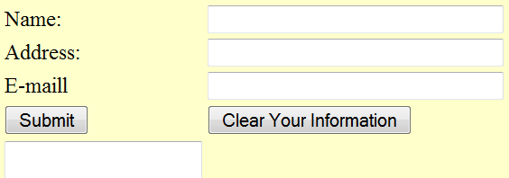
JavaScript and HTML Forms
<HTML>
<HEAD>
<SCRIPT LANGUAGE=JavaScript><!--
function verify(){
with(document.infoform){
if((fullname.value=="")||(address.value=="")||(email.value=="")){
alert("You have left one or more fields blank. Please supply the necessary information, and re-submit the form.");
}
else {
display.value="The following information has been added to our guestbook:\r"+fullname.value+"\r"+ address.value +"\r" +email.value;
}
}
}
//--></SCRIPT>
</HEAD>
<BODY BGCOLOR="#FFFFCC">
<P><FORM name=infoform>
<P><TABLE BORDER=0>
<TR>
<TD WIDTH=83>Name:</TD>
<TD><INPUT TYPE=text NAME=fullname VALUE="" SIZE=32></TD>
</TR>
<TR>
<TD>Address:</TD>
<TD>
<P><INPUT TYPE=text NAME=address VALUE="" SIZE=32>
</TD>
</TR>
<TR>
<TD>E-maill</TD>
<TD><INPUT TYPE=text NAME=email VALUE="" SIZE=32></TD>
</TR>
<TR>
<TD><INPUT TYPE=button VALUE="Submit" onclick="verify()"></TD>
<TD><INPUT TYPE=reset VALUE="Clear Your Information“></TD>
</TR>
<TR><TD><TEXTAREA NAME=display ROWS=5 COLS=41 WRAP=virtual> </TEXTAREA> </TD>
</TR>
</TABLE>
</FORM>
</BODY>
</HTML>

Slide 79
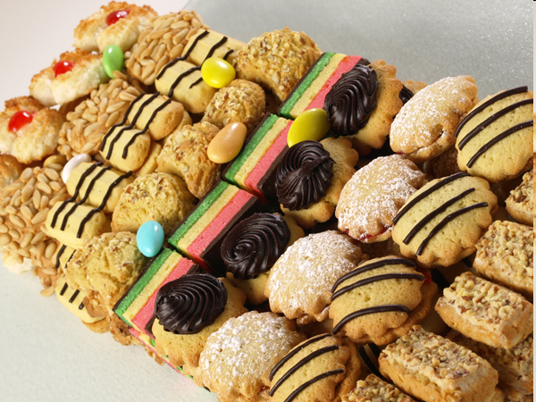
Cookies

Slide 80
What are cookies
small pieces of information that scripts can store on a client-side machine in browser-dependent format in a reasonably secure manner
Cookies used to
store the username and password you enter into a password-protected web site
store user preferences and information about the user’s previous visit to the site – name, date, etc.
store pieces of information to be passed from one page to the other, like shopping cart
Fields of each cookie record with HTTP header access
Domain of the server that created the cookie
Information on whether you need a secure HTTP connection to access the cookie
Pathname of URL(s) capable of accessing the cookie
Expiration date of the cookie
Name of the cookie entry
String data associated with the cookie entry

Slide 81
Working with cookies
Setting and getting cookies with a server-side application relies on HTTP headers
You cannot set a cookie or retrieve one after the page has loaded
a JavaScript script is a client-side application and thus enables you to process cookies at any time, without contacting the server
The cookie property of the document object reflects all cookies that are valid for the web page hosting the script;
document.cookie is equivalent to the Cookie field in the HTTP request header

Slide 82
Working with cookies
Three defined actions related to cookies:
Saving cookies
write cookie data to the cookie file
Retrieving the value of a cookie according to its name
reading cookie data from the cookie file
Deleting a cookie
remove a cookie file
The original object model defines cookies as properties of documents
document.cookie = “string to be stored in cookie”;

Slide 83
Working with cookies
Saving cookie
use a simple JavaScript assignment operator with the document.cookie property
document.cookie = “cookieName=cookieData
[; expires=timeInGMTString]
[; path=pathName]
[; domain=domainName]
[; secure]”

Slide 84
Working with cookies
Saving cookie
Name/Data
Each cookie must have a name and a string value (even if that value is an empty string)
To store the string “Abebe” in the cookie named ‘mycustomer’
document.cookie=“mycustomer=Abebe”
If the browser sees no existing cookie in the current domain with this name, it automatically creates the cookie entry for you; if the named cookie already exists, the browser replaces the old data with the new data

Slide 85
Working with cookies
Saving cookie
all the other cookie properties are optional
The entire name/value pair must be a single string with no semicolons, commas, or character spaces
What if I want to store the string “Aemro B.”?
You cannot save a JavaScript array or object to a cookie
Change array elements to string
Array.join() – convert to string
String.split() – to recreate the array

Slide 86
Working with cookies
Saving cookie
Expires
Specifies the time the cookie will be removed
If left unspecified, the cookie will be deleted when the browser is closed
Expiration dates, when supplied, must be passed as Greenwich Mean Time (GMT) strings
To calculate an expiration date based on today’s date, use the JavaScript Date object as follows:
var exp = new Date();
var oneYearFromNow = exp.getTime() +
(365 * 24 * 60 * 60 * 1000);
exp.setTime(oneYearFromNow);
document.cookie = “userName=Aemro; expires=” + exp.toGMTString();

Slide 87
Working with cookies
Saving cookie
Expires
In the cookie file, the expiration date and time is stored as a numeric value (in seconds) but, to set it, you need to supply the time in GMT format
Path
For client-side cookies, the default path setting (the current directory) is usually the best choice
Domain
Unless you expect the document to be replicated in another server within your domain, you can usually omit the domain parameter when saving a cookie.
Default behavior automatically supplies the domain of the current document to the cookie file entry

Slide 88
Working with cookies
Saving cookie
SECURE
Encrypts the content of the cookie file so that it is not accessible
If you omit the SECURE parameter when saving a cookie, you imply that the cookie data is accessible to any document or server-side program from your site that meets the other domain- and path-matching properties.
For client-side scripting of cookies, you should omit this parameter when saving a cookie.

Slide 89
Working with cookies
Retrieve cookie
Cookie data retrieved through JavaScript is contained in one string, which contains the whole name-data pair
Even though the cookie file stores other parameters for each cookie, you can retrieve only the name-data pairs through JavaScript
When you know that you’re dealing with only one cookie (and that no more will ever be added to the domain)
var data=document.cookie.substring(7,document.cookie.length);

Slide 90
Working with cookies
Retrieve cookie
A better approach to cookie extraction is to create a general-purpose function that can work with single- or multiple-entry cookies
function getCookieData(labelName) {
var labelLen = labelName.length;
var cookieData = document.cookie;
var cLen = cookieData.length;
var i = 0; var cEnd;
while (i < cLen) {
var j = i + labelLen;
if (cookieData.substring(i,j) == labelName) {
cEnd = cookieData.indexOf(“;”,j);
if (cEnd == -1) {
cEnd = cookieData.length; }
return cookieData.substring(j+1, cEnd); }
i++; }
return }

Slide 91
Working with cookies
Delete cookie
Omitting the expiration date signals the browser that this cookie is temporary.
The browser never writes it to the cookie file and forgets it the next time you quit the browser
To delete an already saved cookie change the expires attribute to earlier than the current time
expires=Thu, 01-Jan-70 00:00:01 GMT
document.cookie=“name=value;expires=“+expires;

Slide 92
Working with cookies
Detecting cookie enabled browsers
Two mechanisms:
navigator.cookieEnabled stores the boolean value true if cookie is enabled.
if(navigator.cookieEnabled){
//do something with the cookie
}
Write to the cookie something and try to read it
document.cookie="testcookie" cookieEnabled=(document.cookie.indexOf("test cookie")!=-1)? true : false ;
If(cookieEnabled)
//do something

Slide 93
Cookies
JavaScript provides some limited, persistent storage, called cookies:
Data is stored in a text file on the client
name=value
Multiple values are delimited by a semicolon
Use sparingly. There are limits (generally):
Up to 300 cookies per browser, 20 cookies per web server, and 4 KB of data per cookie
Don’t depend on cookies—users can block or delete them.

Slide 94
Cookies
By default, cookies are destroyed when the browser window is closed, unless you explicitly set the expires attribute.
To persist a cookie, set the expires attribute to a future date.
To delete a cookie, set the expires attribute to a past date.
By default, cookies can only be read by the web page that
wrote them unless you specify one or more of these attributes:
path – allows more than one page on your site to read a cookie.
domain – allows multiple servers to read a cookie.

Slide 95
HTML code
<body onload=“readCookie();”>
<form name="cookieForm" onsubmit=“javascript: return
setCookie();" action=“/cgi-bin/login" method="post">
User ID: <input type="text" name="username"><br>
Password: <input type="password" name="pwd"><br>
<input type="checkbox" name="persist"> Remember user ID
<br>
<input type="submit" value="Submit">
</form>

Slide 96
JavaScript code (set the cookie)‏
function setCookie() {
if (window.document.cookieForm.persist.checked){// Get the date and set it to next year
var expDate = new Date();
expDate.setFullYear(expDate.getFullYear() + 1);
var who = window.document.cookieForm.username.value;
document.cookie = "username=" + who + ";” +
"expires=" + expDate.toGMTString();
} else {
deleteCookie();
}
return true;
}

Slide 97
JavaScript code (read the cookie)‏
function readCookie() {
if (document.cookie) {
var theCookie = document.cookie;
var pos = theCookie.indexOf("username=");
if (pos != -1) {
var cookie_array = theCookie.split("=");
var value = cookie_array[1];
// Load the stored username into the form
window.document.cookieForm.username.value=value;
window.document.cookieForm.persist.checked=true;
}
}
}

Slide 98
JavaScript code (delete the cookie)‏
function deleteCookie() {
if (document.cookie) {
// Get a date and set it to last year
var expDate = new Date();
expDate.setFullYear(expDate.getFullYear() - 1);
document.cookie = "username=" + "" + ";" +
"expires=" + expDate.toGMTString();
}
}

